Slide 1
Hamster Capstone Project
Presentation 2 by: Jared Hemauer, Rylee Horney, Keenan Keams, Joseph Lopez

Slide 2

Project Description
Hamster: Affordable stroke rehabilitation robot.
Targeted at arm and hand movement recovery.
Aims to reduce time and cost for stroke patients in physical therapy.
Sponsored by Dr. Reza Sharif Razavian, NAU professor.
Passionate advocate for stroke rehabilitation robotics with extensive robotics expertise
Joe 1

Slide 3
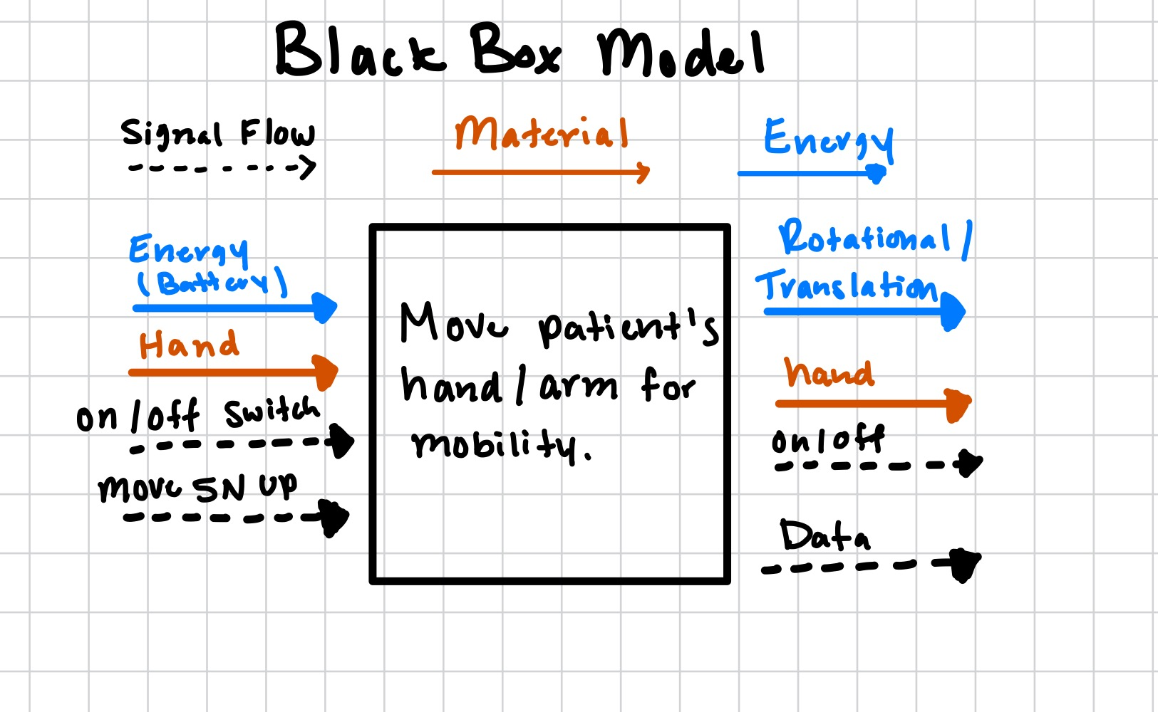
Black box model
Function
  Move patient's hand/arm for mobility movement.
Inputs
  Energy from Battery
  Hand to strap to the device
  On/Off Switch
  Input from the device/computer to move in a direction for some force.
Outputs
  Rotational/Translational energy
  Hand strapped to device
  On/Off switch
  Health data reported more resistance or assistance needed.
Keenan 2

Slide 4
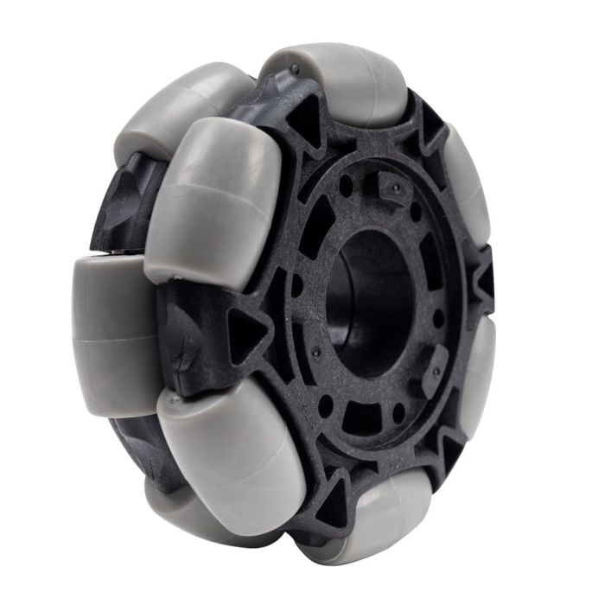
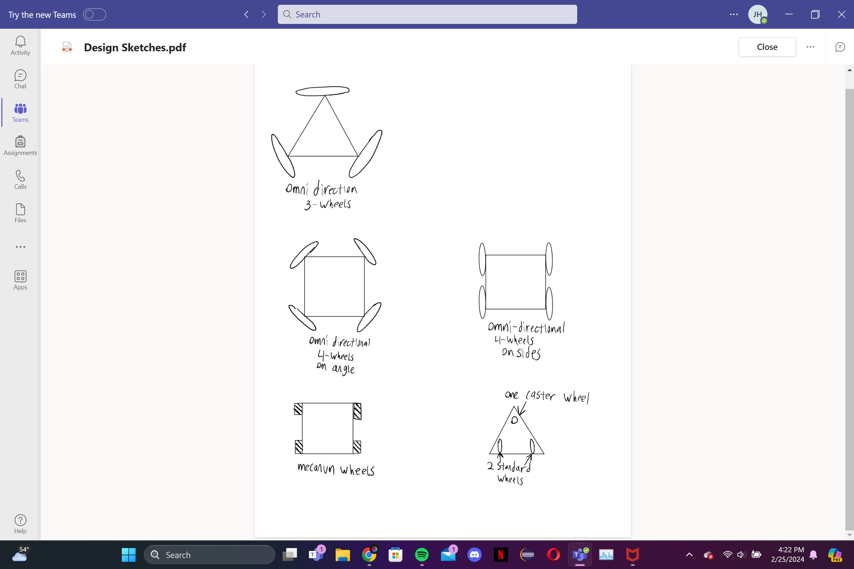
Concept generation: Wheel Layout
3 Omni-directional wheels
  Pros: Cheap, lots of maneuverability
  Cons: Difficult to program
4 Omni-directional wheels at angles
  Pros: More powerful
  Cons: More expensive, even harder to program
4 Omni-directional wheels on sides
  Pros: More powerful
  Cons: More expansive, Can't move horizontally
Mecanum Wheels
  Pros: Great control, easy to program
  Cons: Wheels are expensive
2 Standard Wheels and 1 caster wheel
  Pros: Cheap and easy to make
  Cons: Very limited mobility
Jared, 3

Slide 5
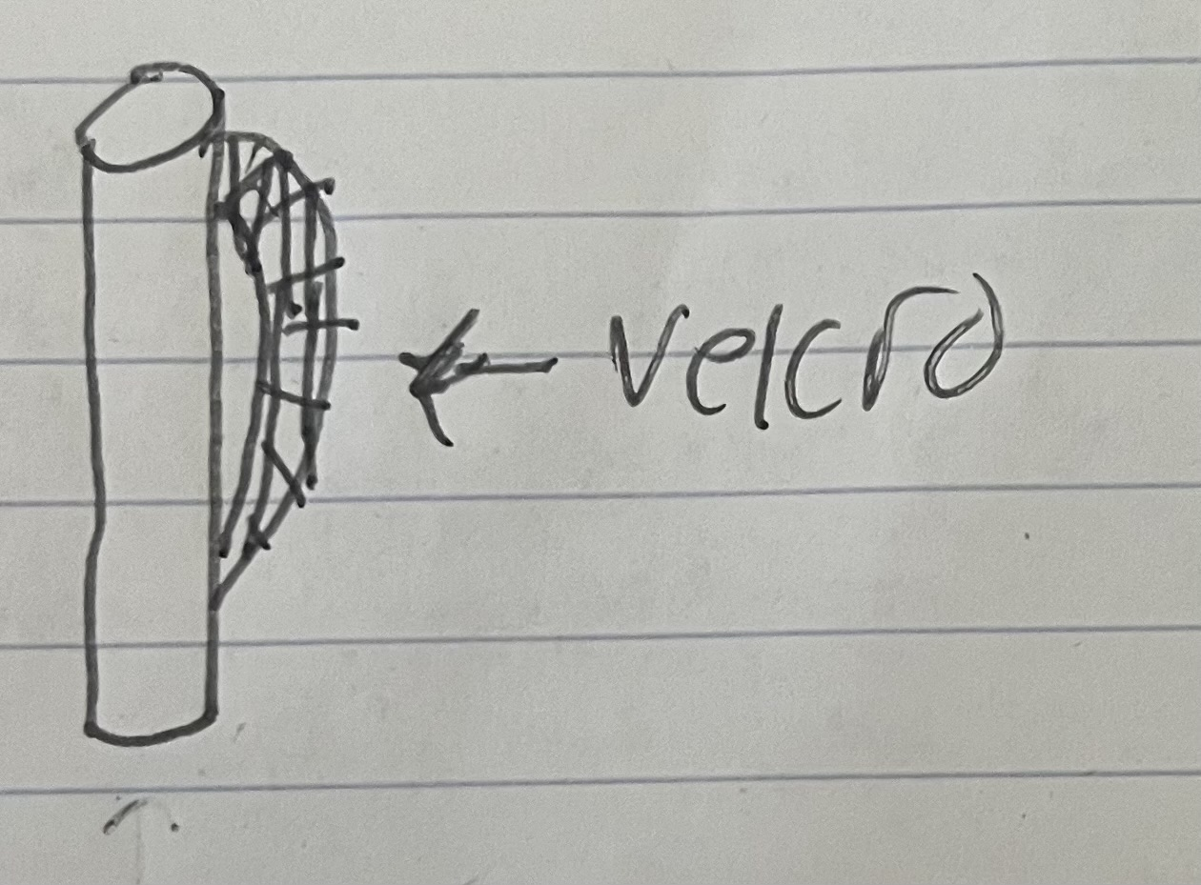
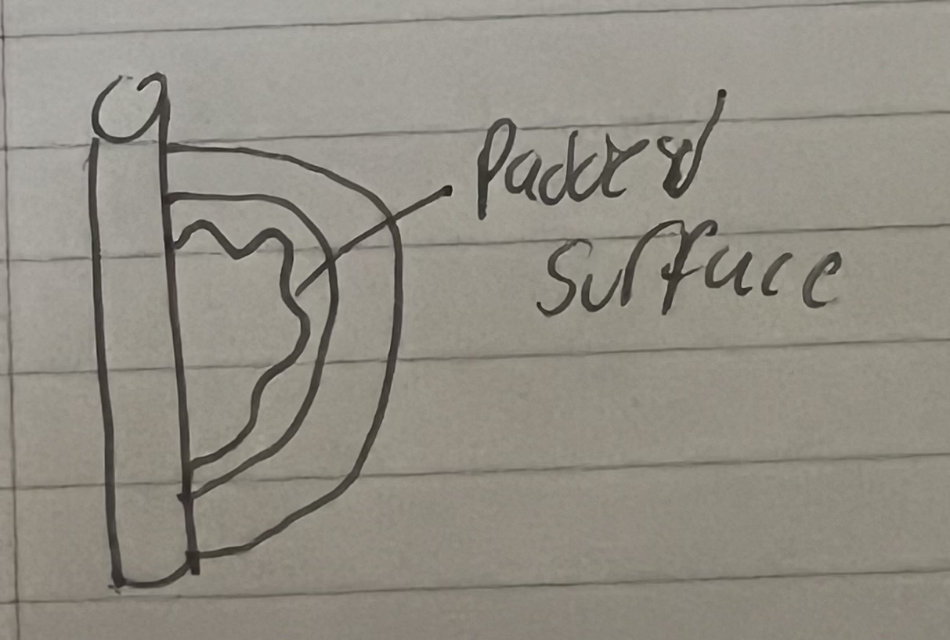
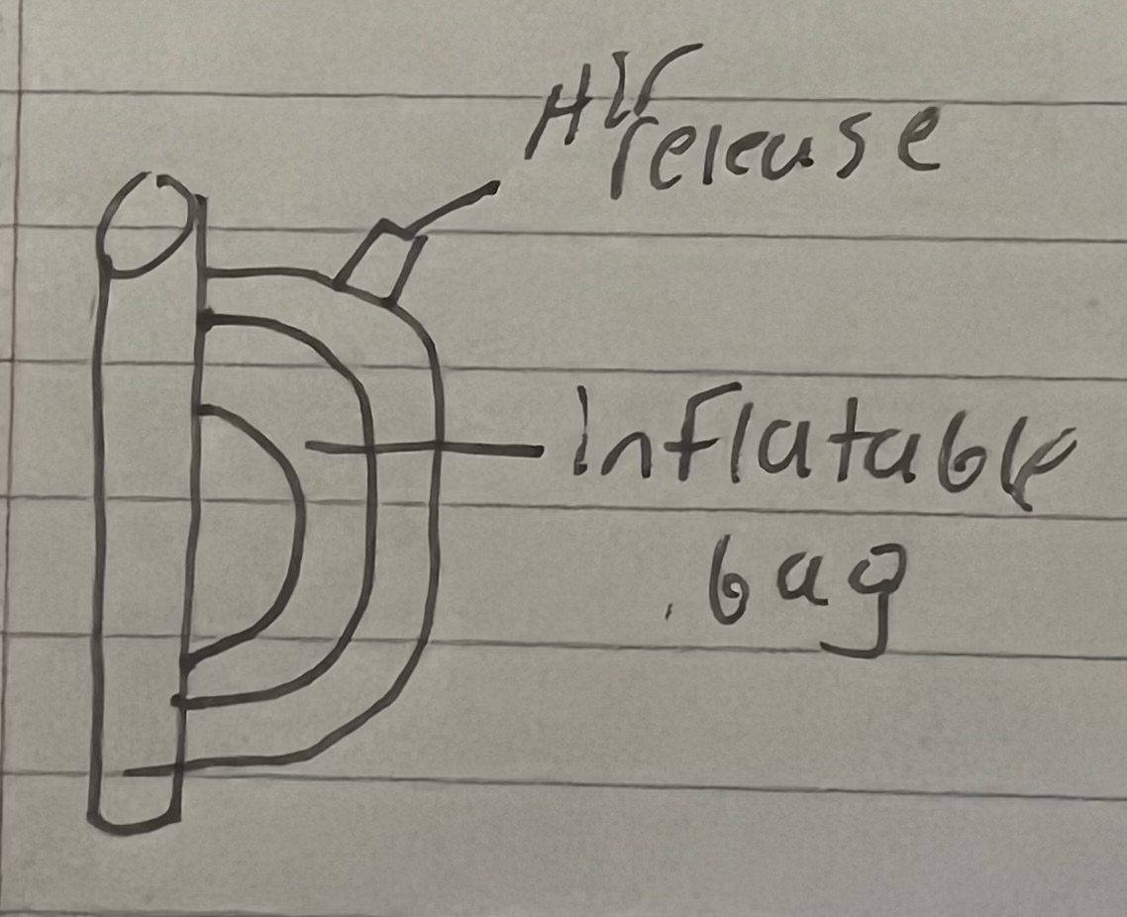
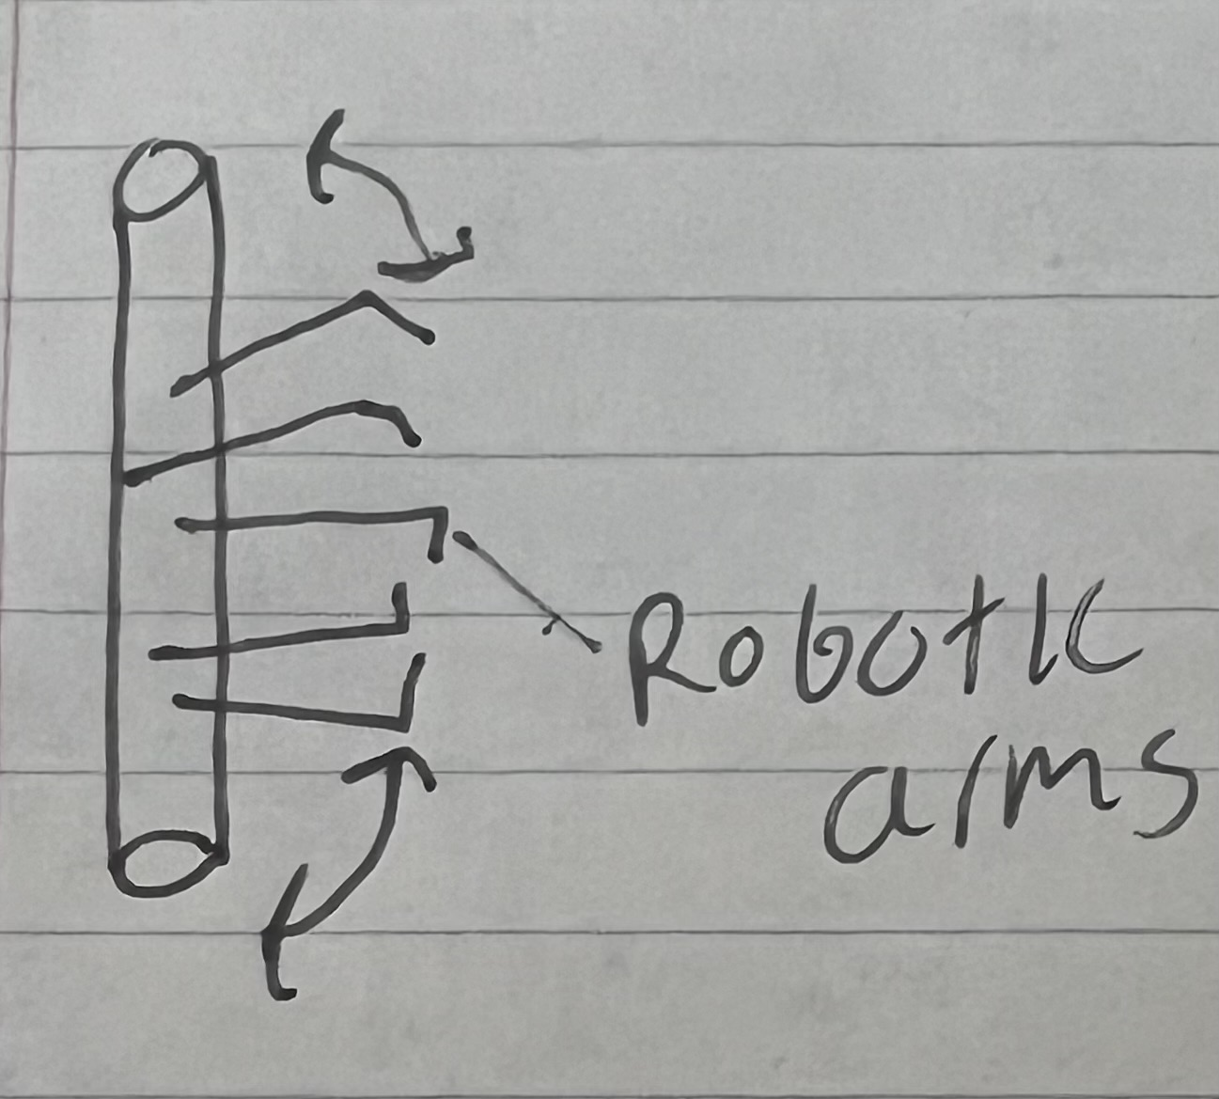
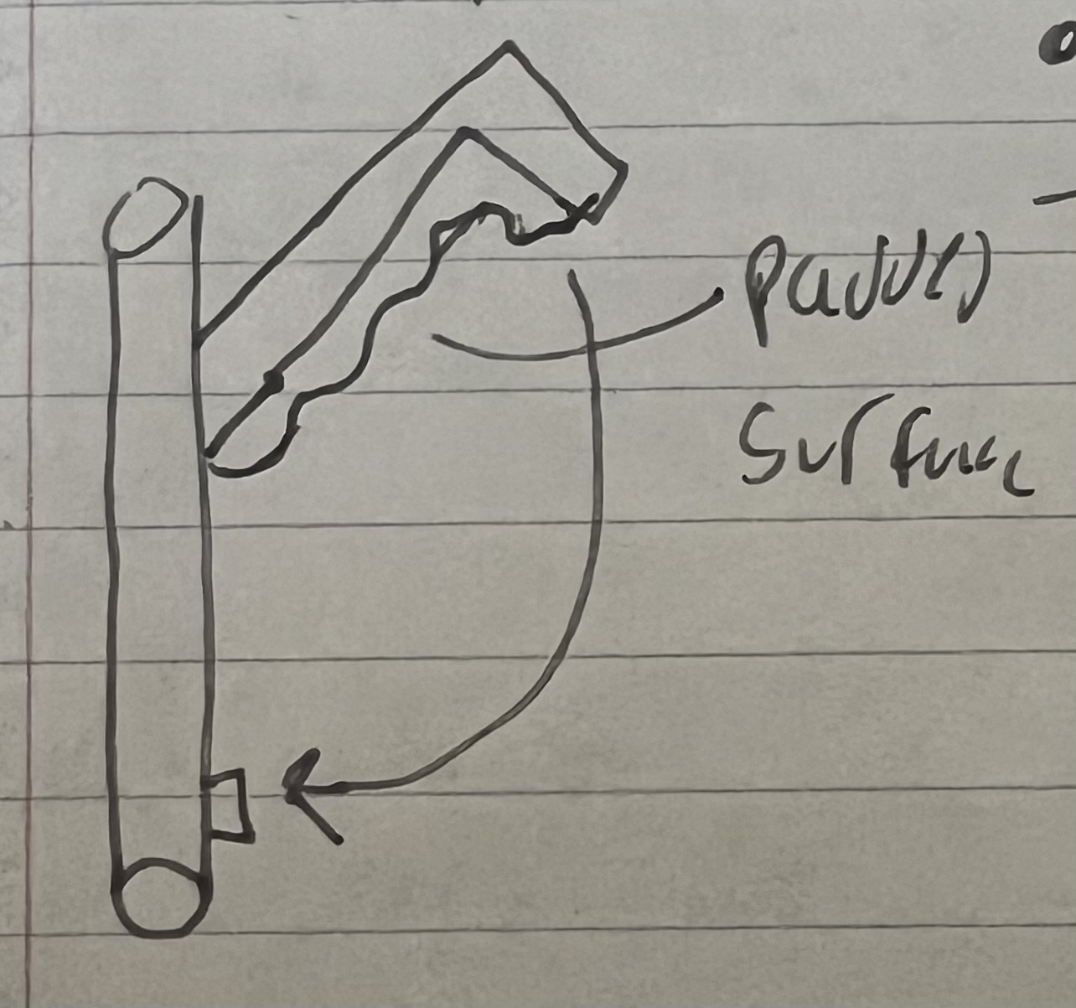
Concept generations: Hand attachment system
Velcro strap concept:
  Pros: Cheap and easy to use.
  Cons: May require two hands; potential irritation for some users.
Friction fit model:
  Pros: Super easy to use; soft material.
  Cons: Not a snug fit.
Air compression fit:
  Pros: Best fitting option.
  Cons: Potential structural issues.
Robotic claws:
  Pros: Automatic fitting.
  Cons: Safety concern if motors break.
Clamp idea:
  Pros: Cost-effective and simple.
  Cons: Not a snug fit.
Joe, 4

Slide 6
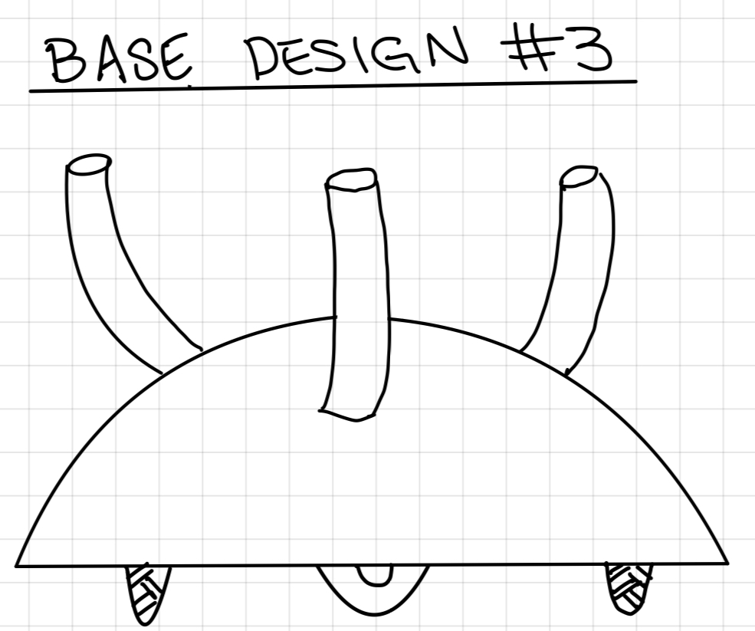
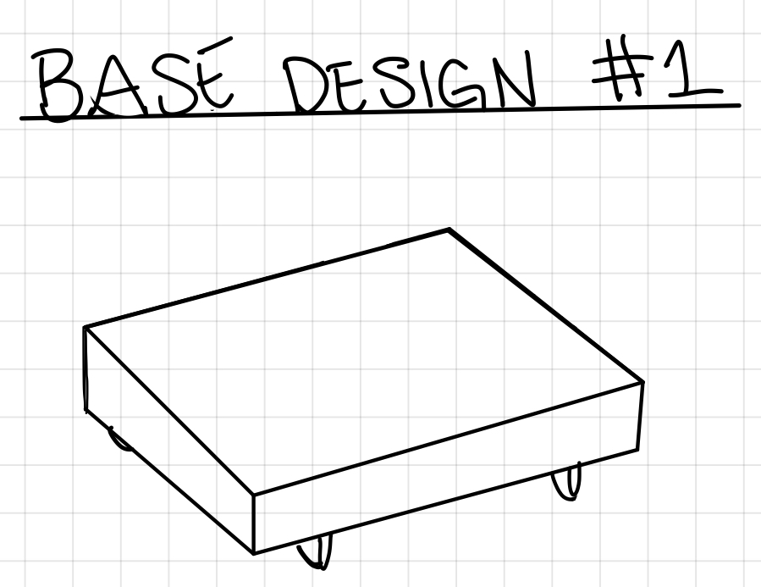
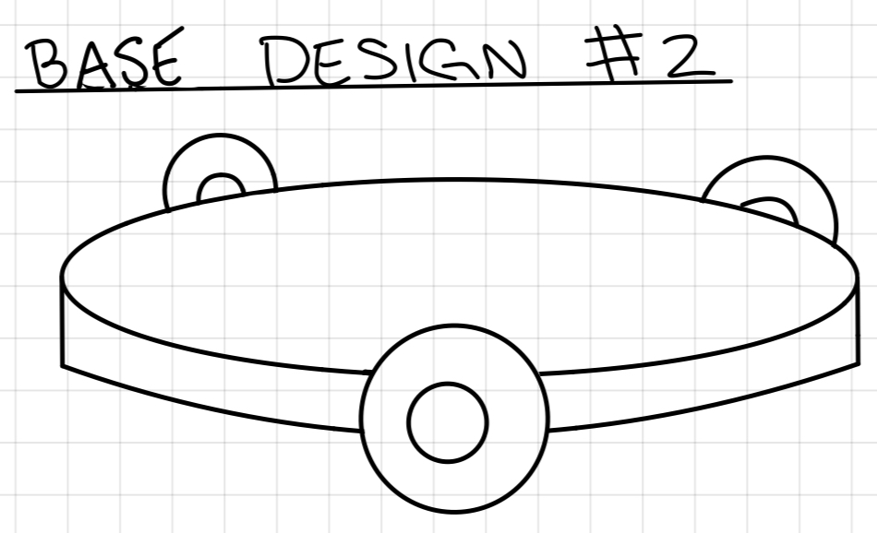
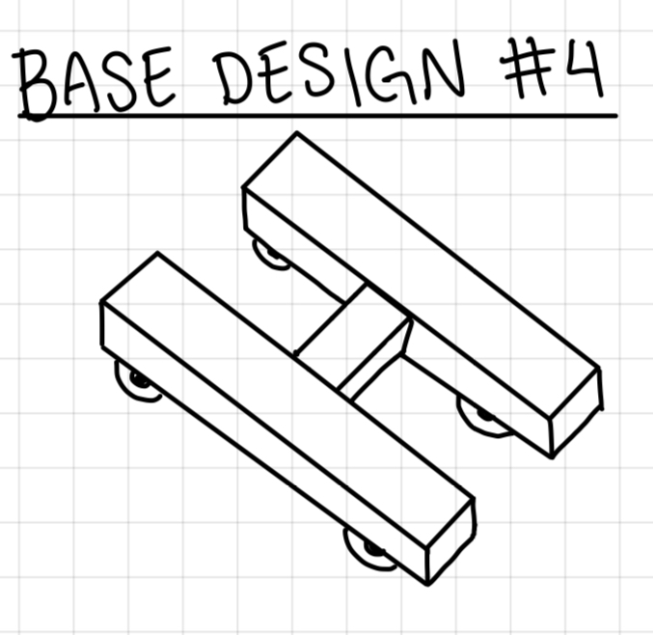
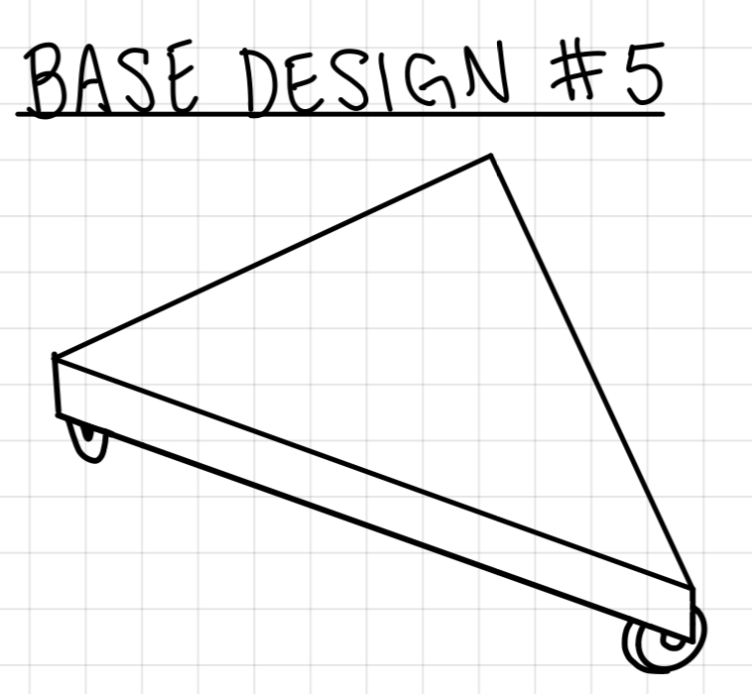
Concept generation: Chassis Design
Square Base
Pro: Be able to fit all components with ample space left over, screen could be placed on base
Con: Could be too large on a desk
Round Base
Pro: Compatible with 3 omni wheels design
Con: Could make it hard to fit all components inside
Dome Base
Pro: Most compatible with the robotic finger's
Con: Would be very tall compared to other designs
H Base
Pro: Less material used to create base
Cons: Will most likely require 4 wheels which increases costs, fitting all internals could prove to be difficult
Triangle Base
Pro: Works for 3-wheel design decreasing costs
Con: Minimal space for internals
Rylee, 5

Slide 7
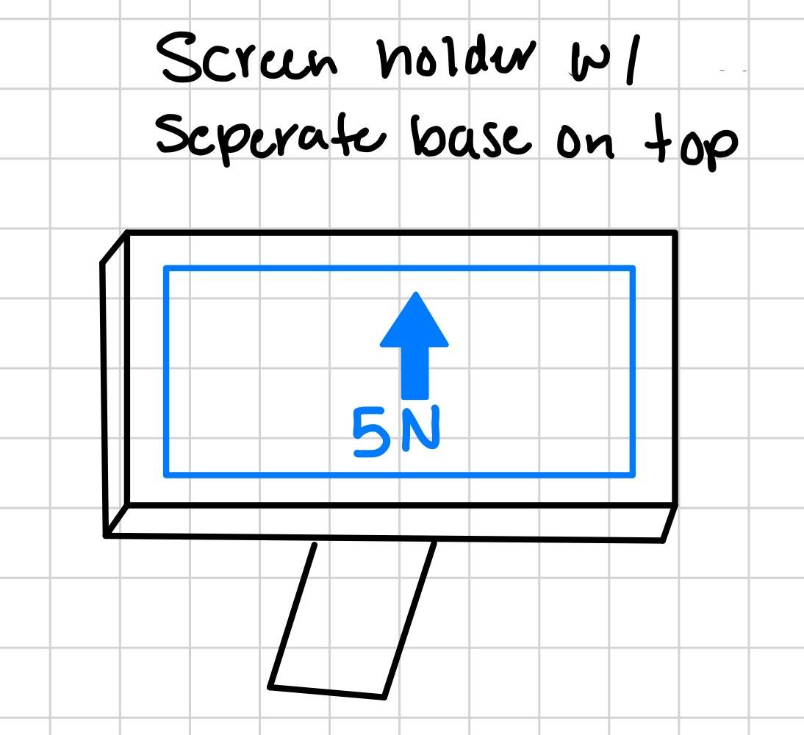
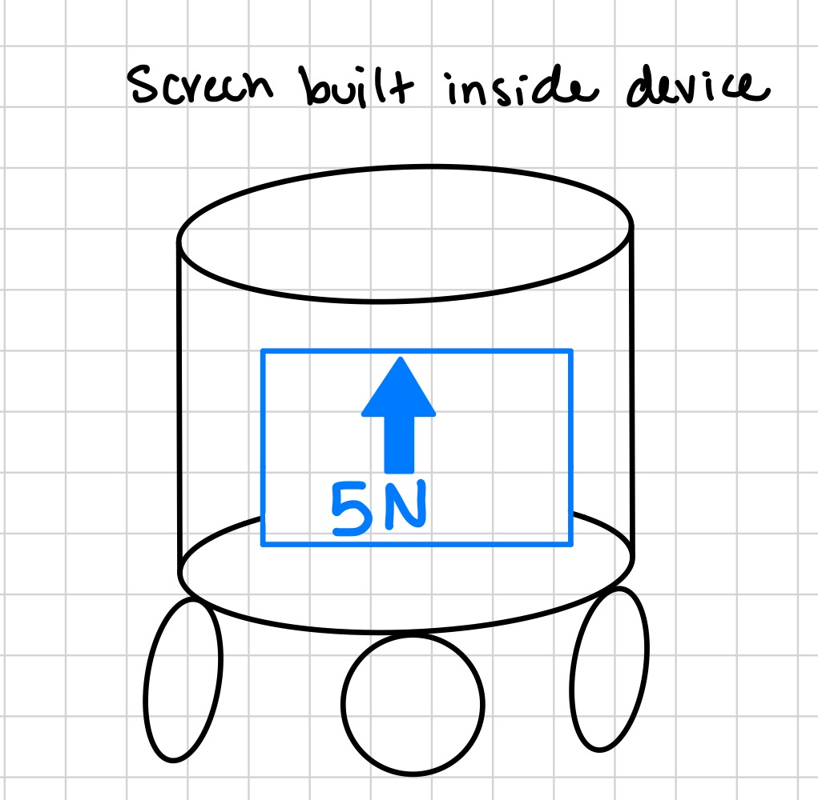
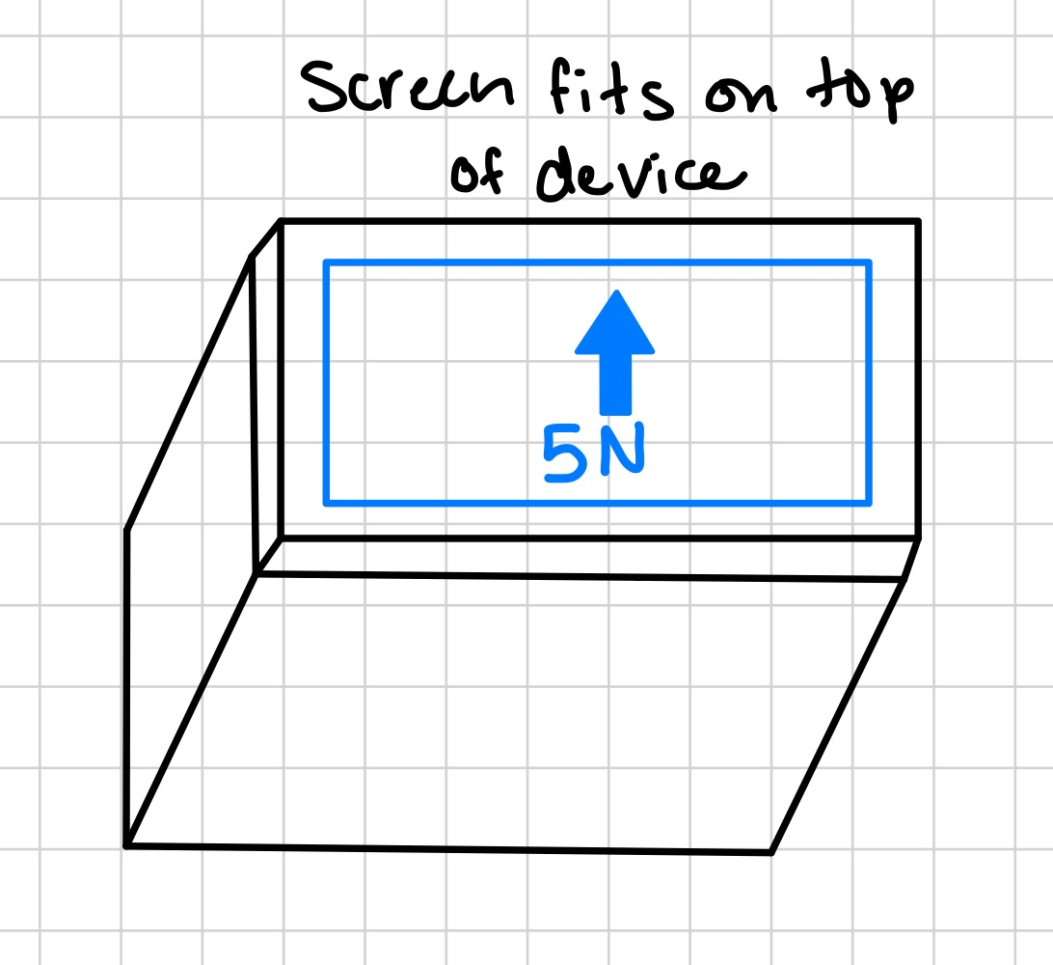
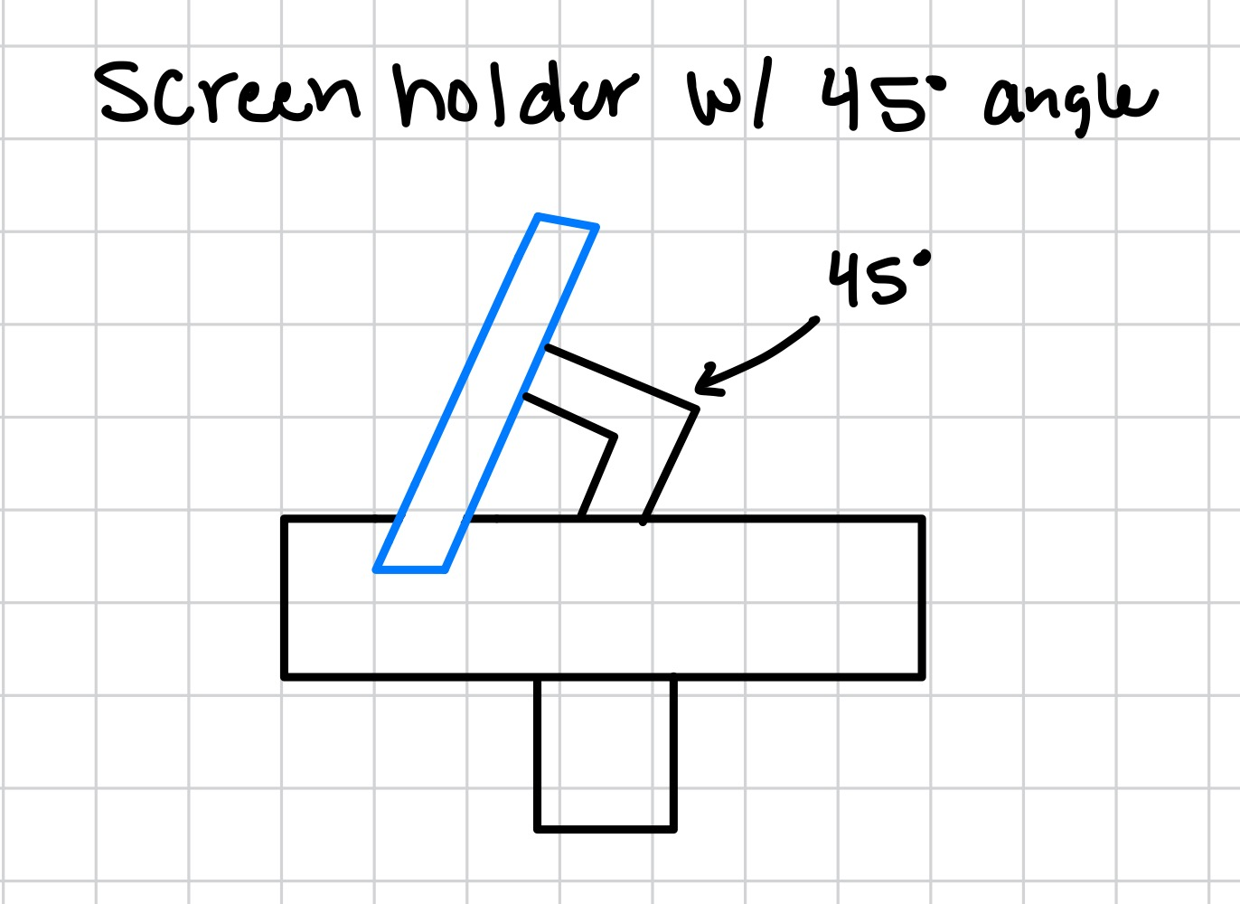
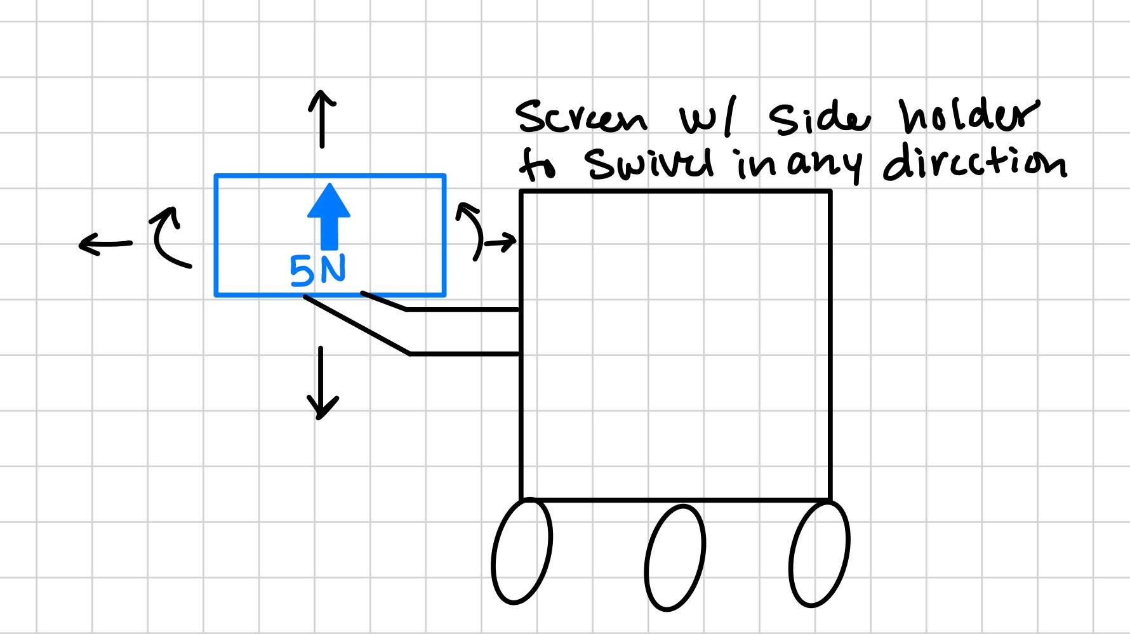
Concept generation: Screen Placement
Screen holder with sperate base on top
  Pro: Can adjust to clients view with less strain on eyes and neck
  Con: Easy to break and cost a little more
Screen built on device
  Pro: Fewer parts and cost
  Con: Can be hidden by arm and can cause strain to clients eyes or neck.
Screen built on top of device
  Pro: Fewer parts and cost
  Con: Can cause strain to clients eyes or neck.
Screen holder with bracket
  Pro: The angle bracket is more comfortable for the client. Can adjust for a moving device. Can switch from right-handed and left-handed clients
  Con: Septable to breaking. More parts and cost
Screen with side holder arm
  Pro: Can switch from right-handed and left-handed clients. Can rotate, and move horizontally and vertically.
  Con: Added length to device. Will start to get loose after multiple adjustments are made. Can easily break if it takes a fall.
Keenan, 6

Slide 8
Engineering Calculations: Motor Speed
In order to know what type of motor we would need for this project we need to know how fast it needs to rotate to meet our desired speed (1m/s).
RPM=(V*60)/(2*π*r)
V=velocity = 1m/s
R= radius of the wheel = 29mm
RPM=329.3rpm
Jared, 7

Slide 9
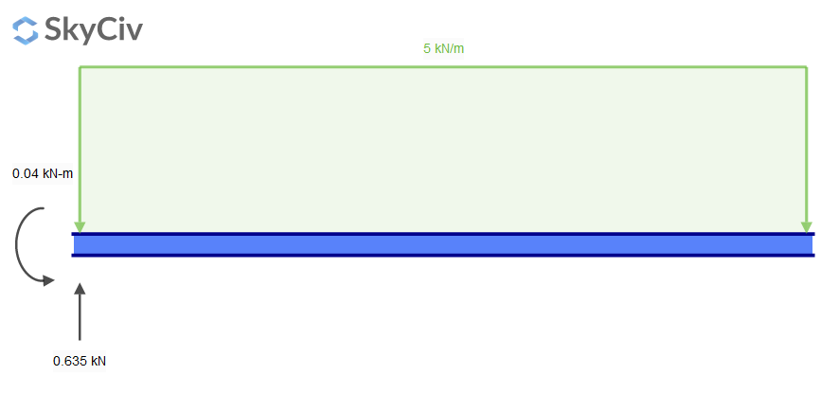

Engineering Calculations Cont.
Utilized SkyCiv website to visualize hand area as a beam supported at the base of the robot.
Moment equation yielded a value of 0.04 kN/m.
Chose a distributed load of 5 Newtons to match sponsor's desired force direction; calculation applicable to all sides of the beam.
Joe, 8

Slide 10
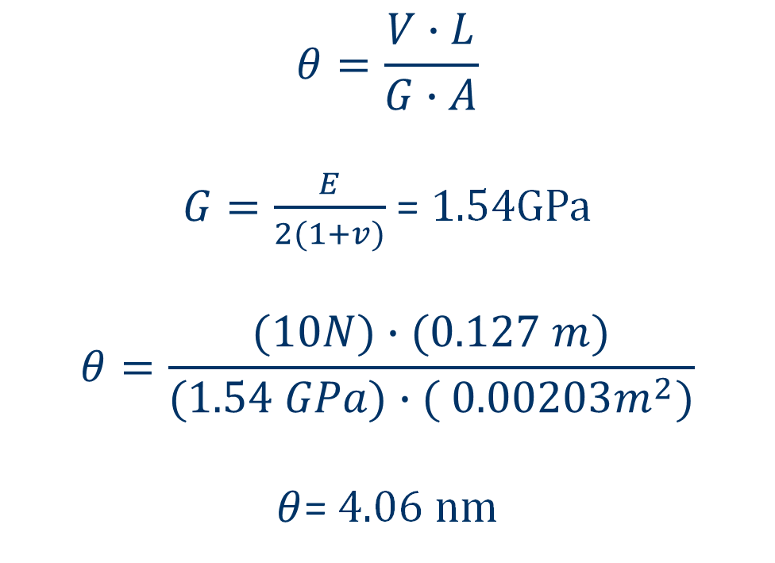
Engineering Calculations Cont.
Shear Deformation of PLA Filament
V= shear force (10N)
A= cross-sectional area ( 2.03 mm²)
E= Young’s modulus (4.107 GPa [2])
L= length ( 127 mm)
G= shear modulus of elasticity
v = Poisson’s ratio (0.332 [2])
[2] V. C. Pinto et al., “Comparative Failure Analysis of PLA, PLA/GNP and PLA/CNT-COOH Biodegradable Nanocomposites thin Films,” Procedia Engineering, vol. 114, pp. 635–642, 2015, doi: 10.1016/j.proeng.2015.08.004.
$$θ=\frac{V∙L}{G∙A}$$
$G=\frac{E}{2(1+v)}$ = 1.54GPa
$$θ=\frac{(10N)∙(0.127 m)}{(1.54 GPa)∙( {0.00203m}^{2})}$$
$θ$= 4.06 nm
Rylee, 9

Slide 11
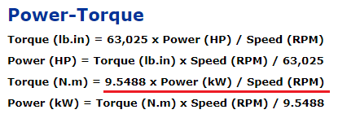
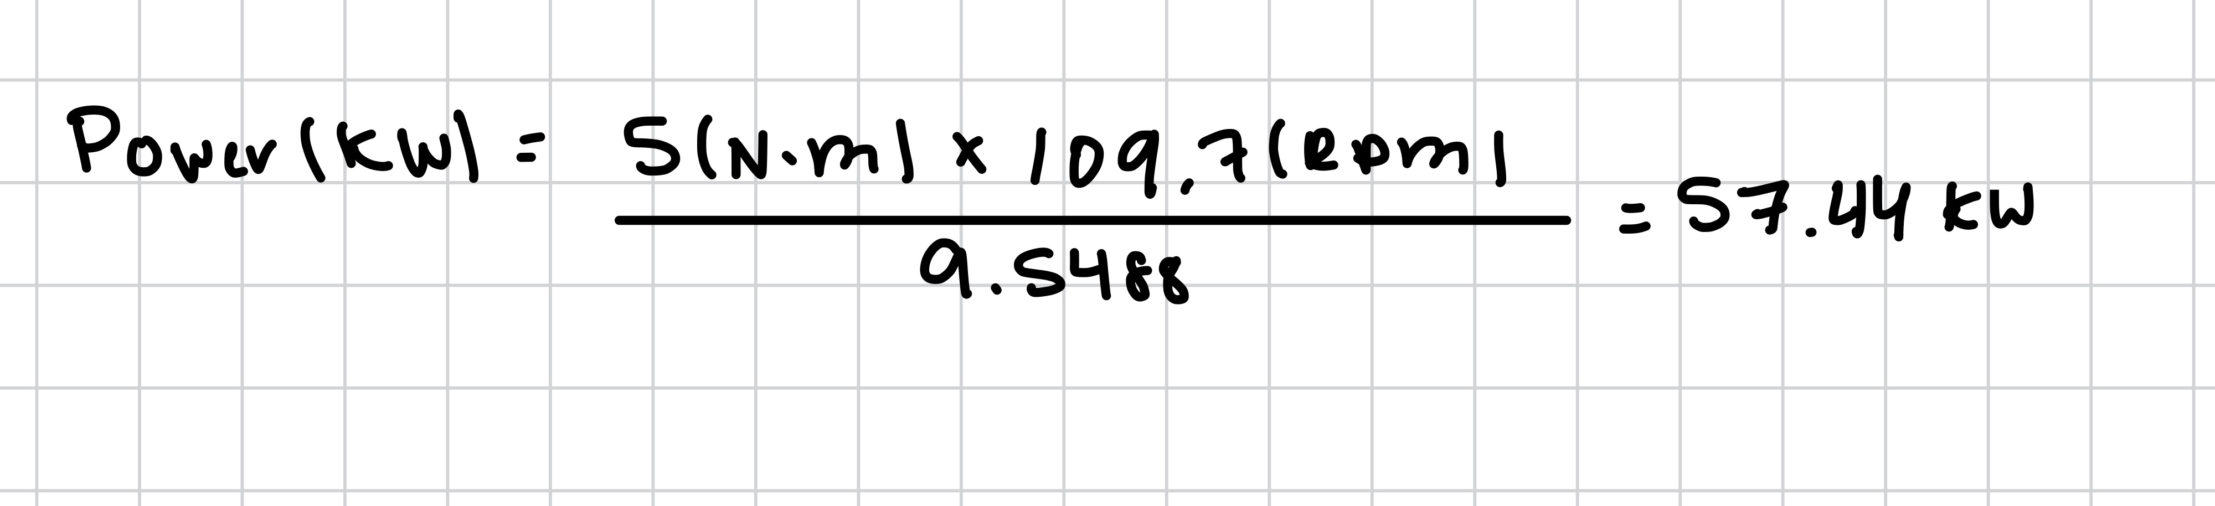
Engineering Calculations Cont.
From previous slides, we calculated RPM from the wheels being 329.3 RPM so per wheel is 109.1 RPM. We would need that to calculate the power output using torque and wheel RPM. Once we get the power output we need to find a motor that runs the power and RPM needed at 70-80% of the max power.
Keenan, 10

Slide 12
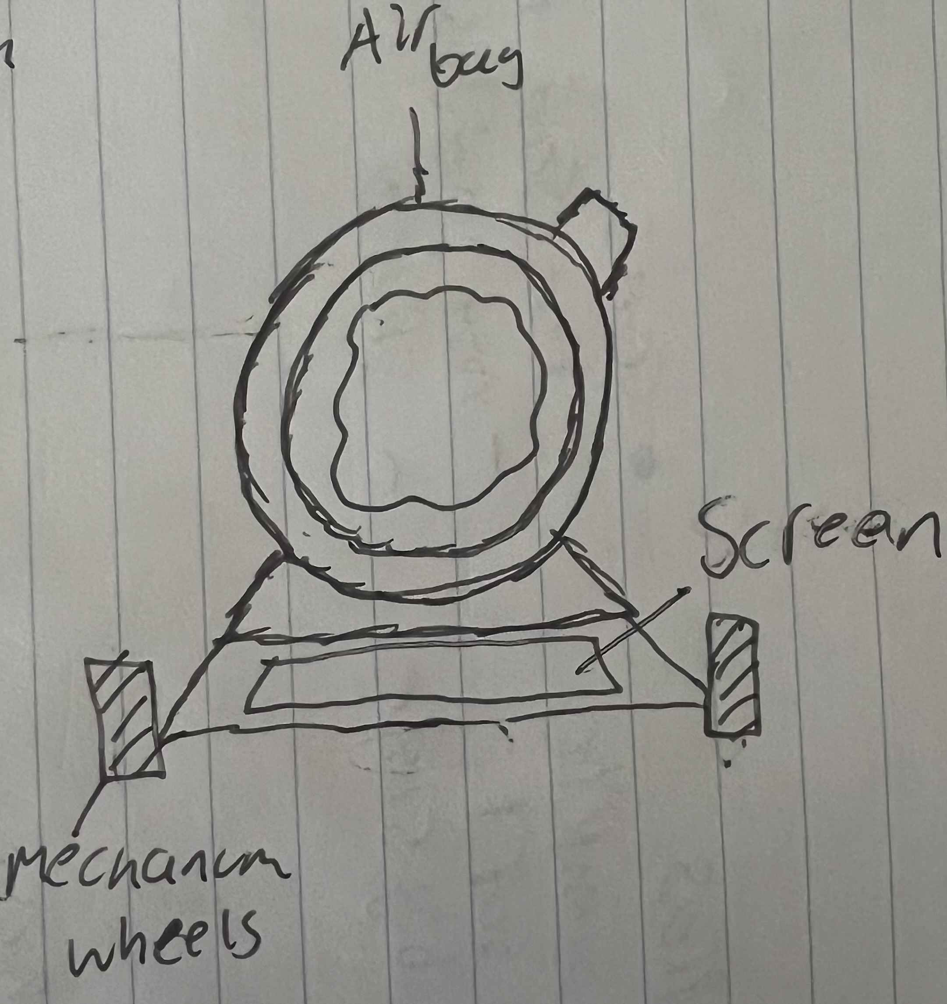
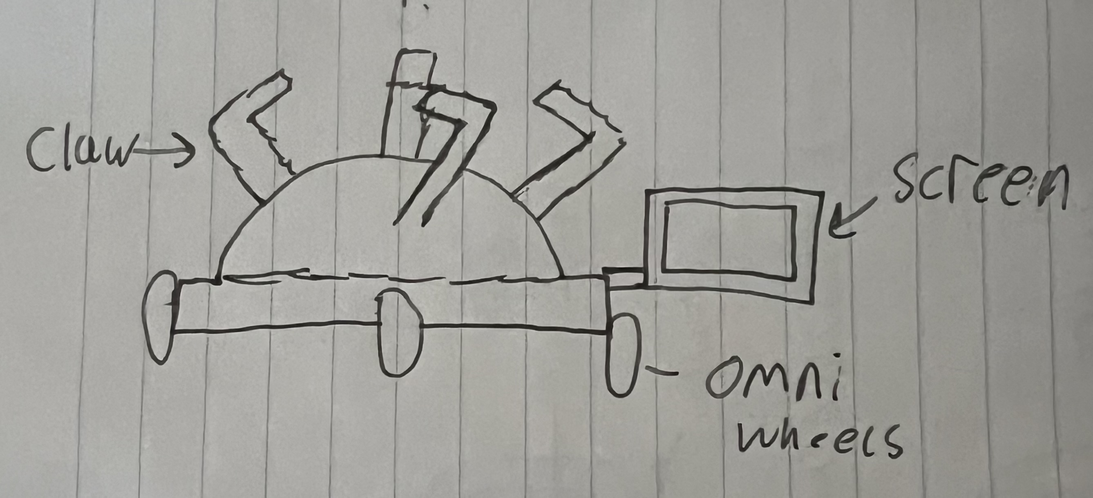
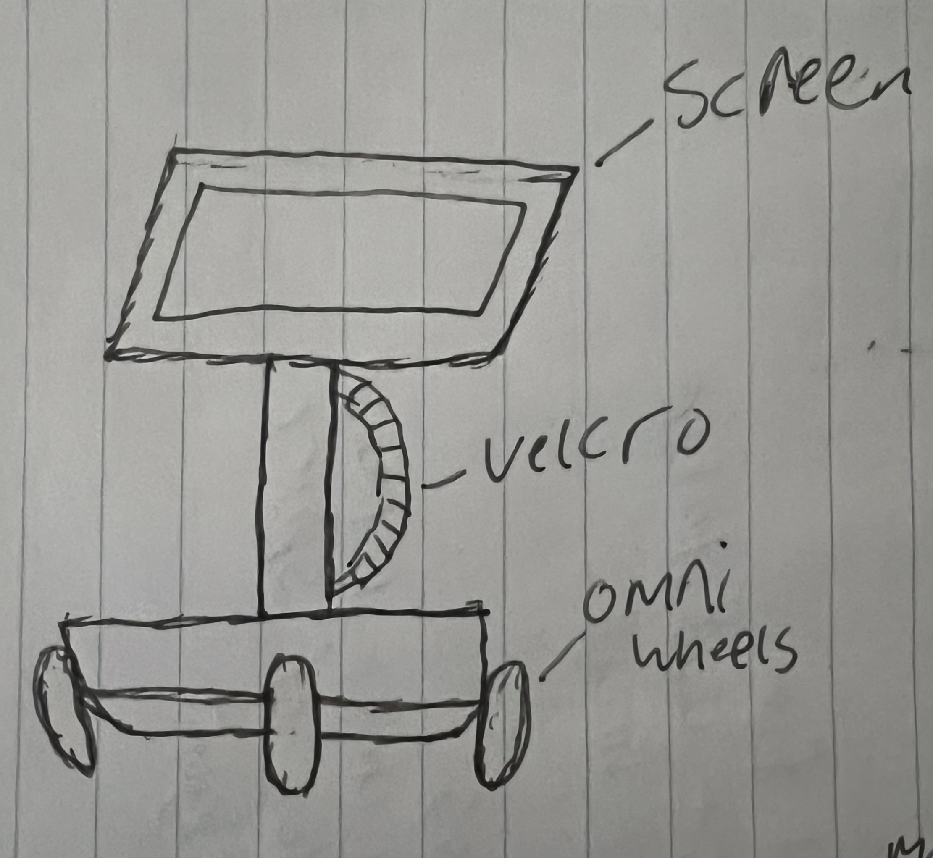
Designs in Decision Matrix
Design #2
Design #1
Design #3
Joe 11

Slide 13
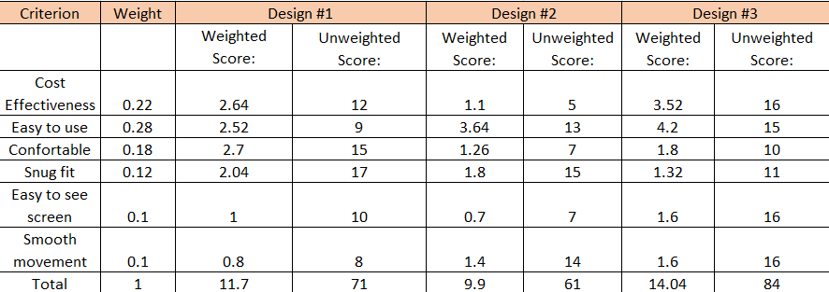
Decision matrix
Joe 12

Slide 14
Concept Selection (Pugh chart)
Concept/Criteria | Design 1 | Design 2 | Design 3
Cost Effectiveness | - | Datum | +
Ease of use | - | Datum | +
Snug fit | + | Datum | S
Comfortable | + | Datum | S
Easy to see screen | S | Datum | +
Smooth Movement | - | Datum | S
Σ+ | 2 |  | 3
Σ- | 3 |  | 0
ΣS | 1 |  | 3
Jared 13

Slide 15
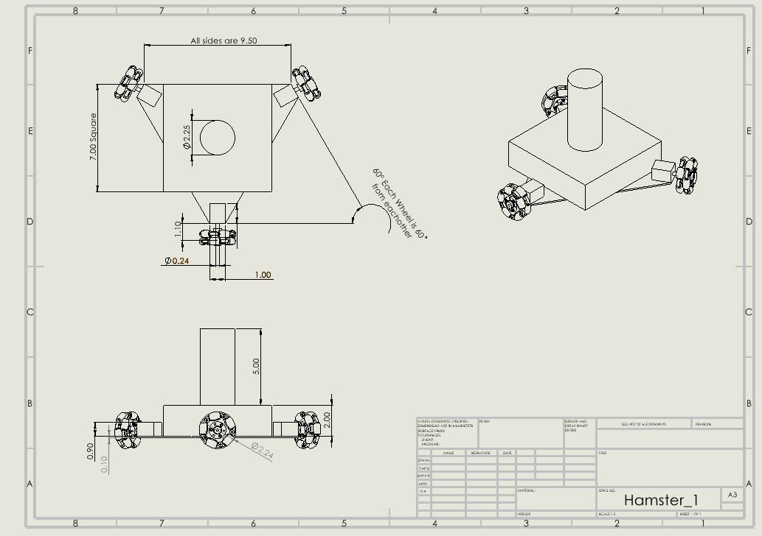
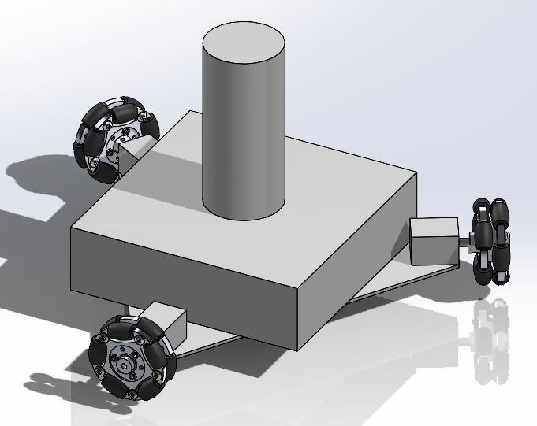
CAD and Final design
Final design is heavily based on design 3:
  3 Omni-directional wheels
  Center Box will be used to hold electronics and batteries
  Center post is where user will grab onto and will have a Velcro strap.
Jared, 14

Slide 16
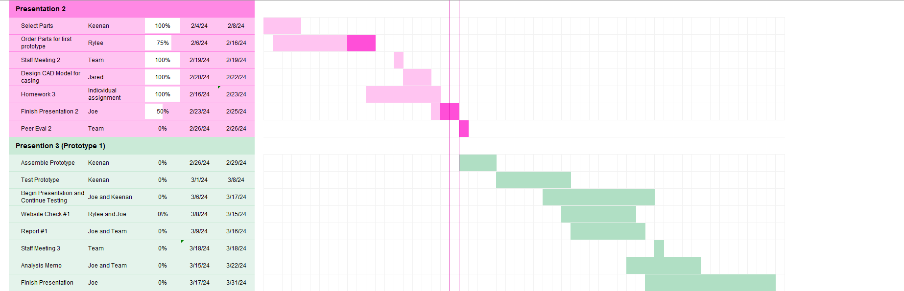
Gantt Chart
Joe, 15

Slide 17

Budgeting and anticipated expenses
Budget: $1000
This amount is from the client
Fundraised Money: $100
Total: $1100
Expenses to Date: $0
Anticipated Expenses: ~ $800
Includes most components for final design and manufacturing costs
[3] C. Cavey, “Project Budget Management Guide with Free Template,” Hubstaff Blog, https://hubstaff.com/blog/project-budget-management-guide/ (accessed Feb. 25, 2024).
Rylee, 16

Slide 18
Tentative BoM
Part | Cost of Part | Quantity | Estimated Total Cost
PLA | $20 | 1-2 spools | $40
Omni-Directional Wheels | $30-$40 | 3 wheels | $90-$120
Microcontroller (Arduino, Raspberri-Pi, etc) | $20-$30 | 1 | $20-$30
Battery | $30-$50 | 1 | $30-$50
Motor(s) | $70-$100 | 3 | $210-$300
Velcro | $8 (roll) | 1 | $8
Screen | $30 | 1 | $30
Sensor | $20 | 1 | $20
ON/OFF Switch | $5 | 1 | $5
Motor drivers | $20 | 3 | $60
Rylee, 17

Slide 19
Thank you

